Slide 1
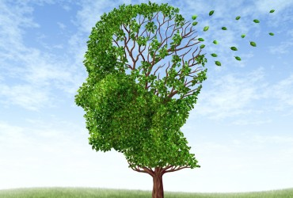
Living Next Door to Dementia
Awareness
Recognition
Understanding
Living Next Door to Dementia
Part 1:
Awareness
presented by
Mary Donnelly
maryd@teepasnow.com

Slide 2
DEMENTIA
Alzheimer’s
Disease
Young Onset
Late Life Onset
Lewy Body Dementia
Other Dementias
Genetic syndromes
Metabolic pxs
ETOH related
Drugs/toxin exposure
White matter diseases
Mass effects
Depression(?) or Other Mental conditions
Infections – BBB cross
Parkinson’s
Vascular
Dementias
(Multi-infarct)
Fronto-
Temporal Lobe Dementias

Slide 3
Dementia 101
Not a disease, but a set of symptoms caused by a disease
MCI – 75% progress to full dementia
Early Stage (any age) vs. Early Onset (symptoms began prior to age 65)
NOT a mental illness
More than just “memory loss” – it’s actually structural & chemical Brain Failure
Inconsistent, symptoms may come and go
Progressive and degenerative – on the move
Terminal

Slide 4
Facts & Figures
Biggest risk factor is aging – only 10-12% under age 65
Only one of the top ten medical conditions without an effective treatment, preventative, or cure
Most expensive – will bankrupt Medicare and Medicaid
WNC has higher average based on older population – more than 10,000 living with dementia in WNC

Slide 6
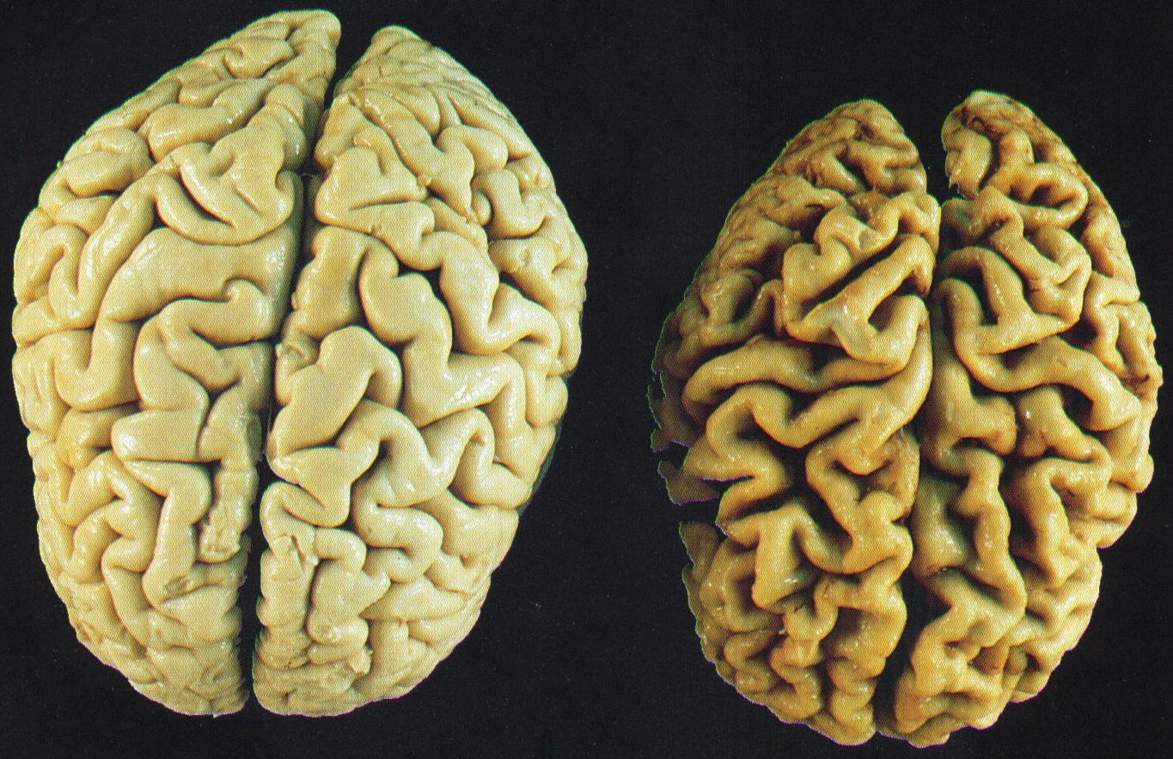
Normal Brain
Alzheimer’s Brain
Normal Brain
Alzheimers Brain

Slide 7
Dementia is more than just memory loss.
Dementia is Brain Failure.
Memory & Information Processing – new AND old
Thinking Skills – “Executive Function” – this is the Big One
Language – comprehension AND word usage
Personality – emotions are driving the train!

Slide 9
People living with dementia
are doing the best they can
with what they have to work with.

Slide 10
But some things remain:
Music/rhythm – including rhythm of speech
Creativity and imagination – art & play, but also confabulation
Social chitchat & forbidden words
Certain kinds of memory – procedural, muscle
Hearing
Emotional memories – joy, fear, sadness, grief, pleasure, loneliness, and love
Connection shifts to the heart, not the head

Slide 11
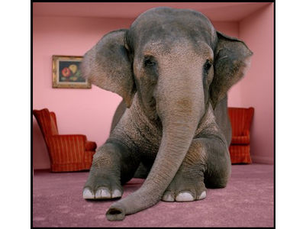

Slide 12
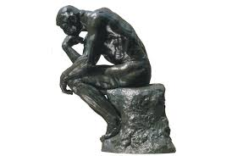
Be thinking ….
How well do you think you’d be doing if YOU were living with brain failure?
How can you support the families in your community who are coping with dementia?
What are some things that you could do to be more “Dementia Friendly?”

Slide 13

“Dementia doesn’t rob someone
of their dignity.
It’s our reaction to them that does.”
- Teepa Snow

